Slide 1
CH 3021: Spectroscopy
Thusitha Abeytunga

Slide 2
Course details
CH3021: Spectroscopy (3 Credits)
– 45 Lecture hours in total
Organic spectroscopy section (covers NMR and Mass spectrometry)
– 18 Lecture hours allocated (Wed: 9.00 -10.00 am weeks 1-12 and 8.00-10.00 am weeks 13-15)
Location: NCLT

Slide 3
Syllabus
Introduction to NMR and MS.
NMR Spectroscopy: Magnetic nuclei, CW and Pulsed FT NMR, Signal to noise ratio, Effects of high field, Chemical shift and factors affecting chemical shift
Coupling constants and mechanism of coupling, Chemical equivalence and magnetic equivalence, Homotopic, enantiotopic and diastereotopic nuclei
NOE effect, Protons on hetero atoms, Second order spectra, Shift reagents and chiral resolving agents
¹³C NMR spectroscopy, The APT and DEPT experiments, Introduction to 2D NMR, COSY, HETCOR and HMBC spectra, Applications in structure elucidation of organic molecules.
Mass Spectrometry: EI and fragmentation mechanisms, CI, FAB, MALDI, Electrospray ionization, MS/MS in structure elucidation of organic molecules.

Slide 4
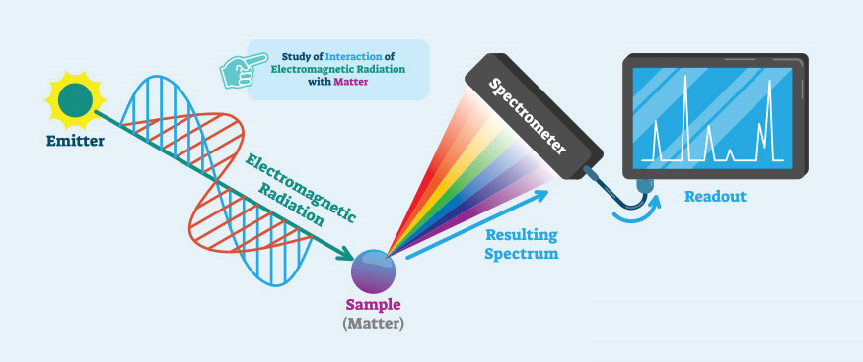
Spectroscopy
In the simplest terms spectroscopy is the study of the interaction of matter with radiation
The interaction of matter with radiation can result in absorption, emission or scattering phenomena.
Since we cannot directly visualize molecules, the study of these phenomena can be used to understand structural information about a molecule.

Slide 5
Importance of spectroscopy in synthesis
Knowing the structure i.e. atoms involved and how they are bonded (connectivity) in a molecule is a critical aspect in making compounds
This is provides critical information when carrying out a synthesis
- Is your starting material pure: Is it what you think it is
- Is you reaction complete?
- are there any by-products? What are they?
- after purification is the product you isolated actually what you wanted to make? How pure is it?
In the early days of synthetic organic chemistry (before the 1950s) determining molecular structure was extremely challenging

Slide 6
Historical development
Prior to the widespread use NMR spectroscopy the tools available to synthetic organic chemists for molecular structure determination were very limited. E.g. Elemental analysis, melting point determination (sometimes with derivatization), very limited mass spectrometric methods
By the 1940s UV/visible and some IR spectroscopy were being used. However, their utility was limited.
The adaptation of 1D NMR spectroscopy in the 1950s and 2D NMR spectroscopy in the 1970s enabled accurate structure elucidation had a huge impact on the development of synthetic chemistry.
Today hundreds of different spectroscopic methods are available

Slide 7
NMR spectroscopy: Introduction
NMR: Nuclear Magnetic Resonance
By far the most important and the most widely used characterization method in synthetic chemistry
Proton NMR spectroscopy is most commonly used
Prerequisite: Second year ¹H NMR spectroscopy knowledge

Slide 8
Quick overview
Please attempt the structure elucidation questions in the practical class

Slide 9
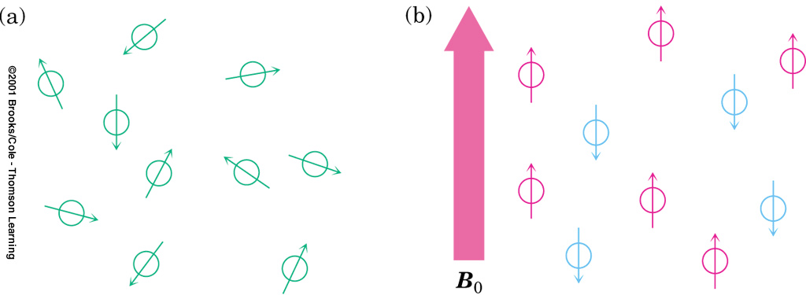

Slide 10
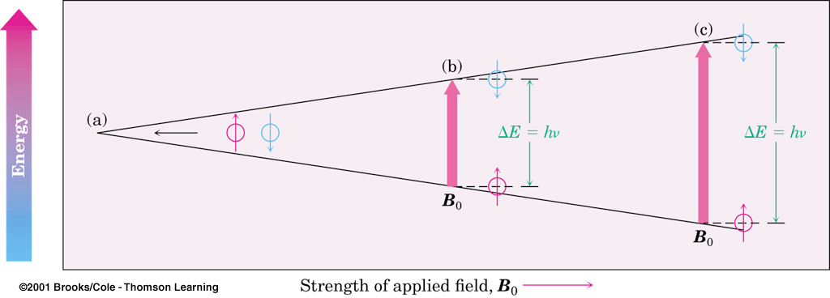

Slide 11
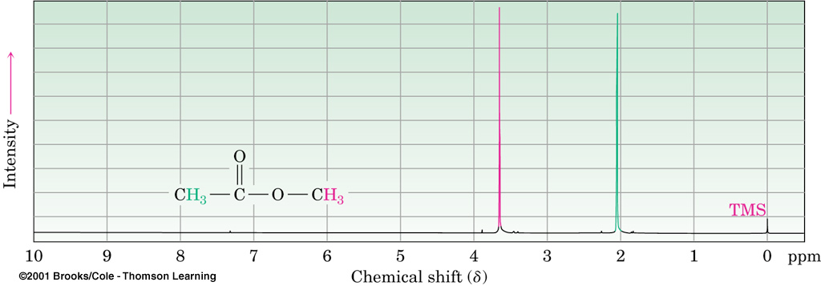

Slide 12
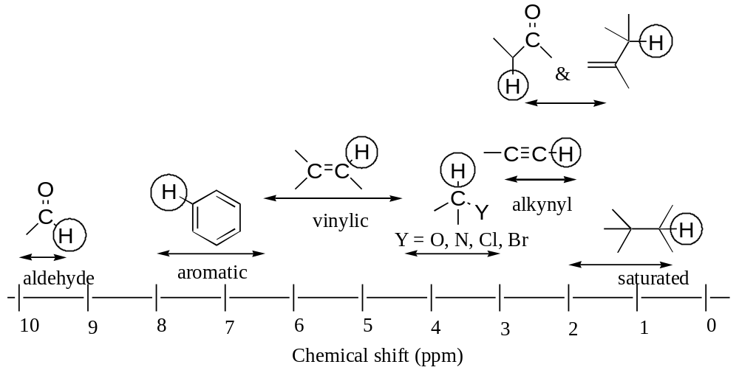
Chemical shift regions of different classes of protons (circled) in 1H NMR spectra

Slide 13
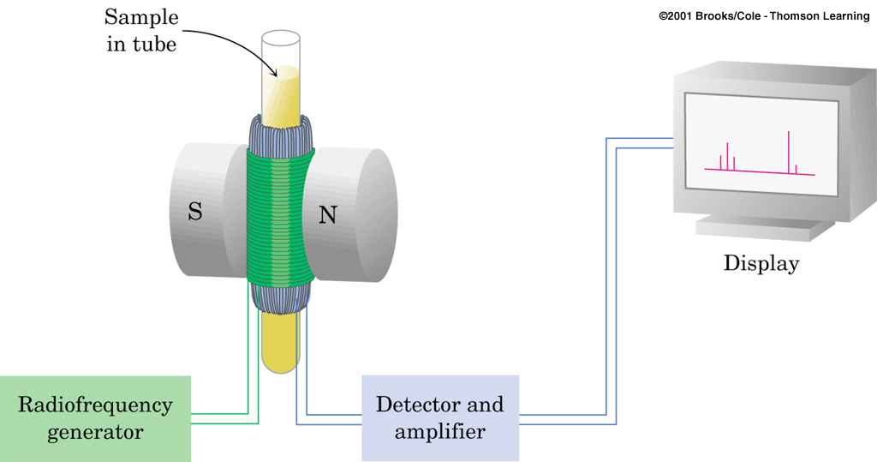

Slide 14
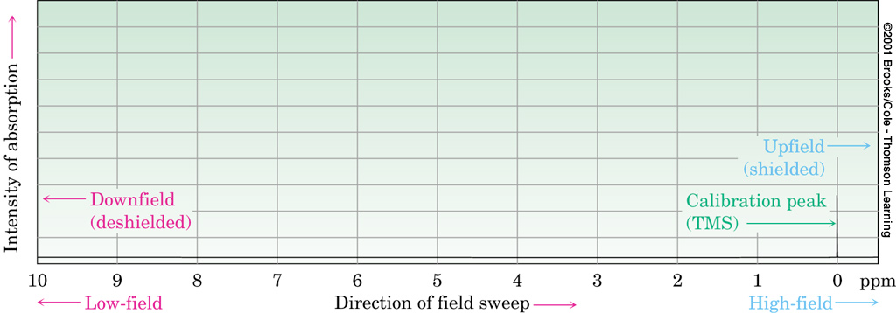

Slide 15
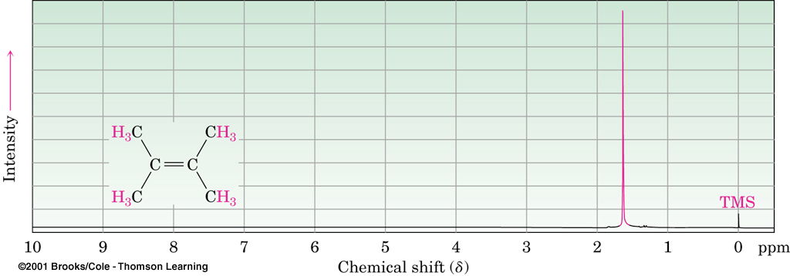

Slide 16
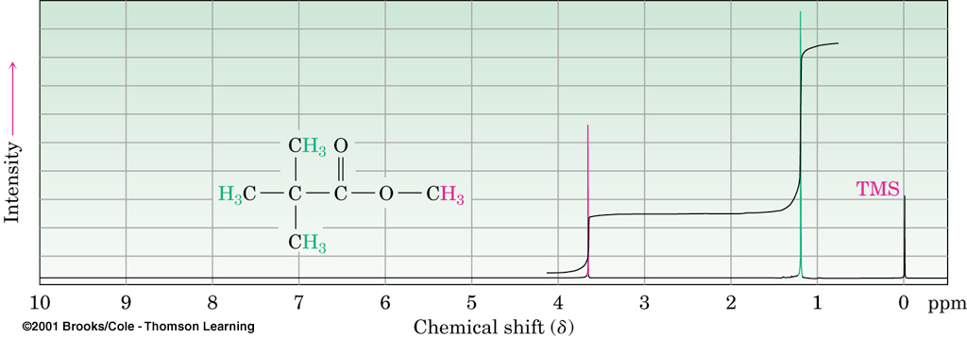

Slide 17
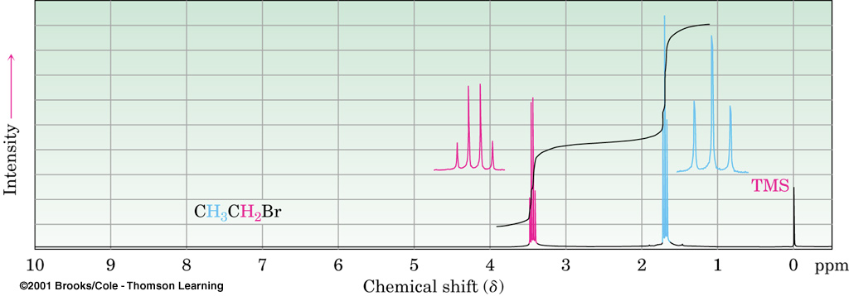

Slide 18
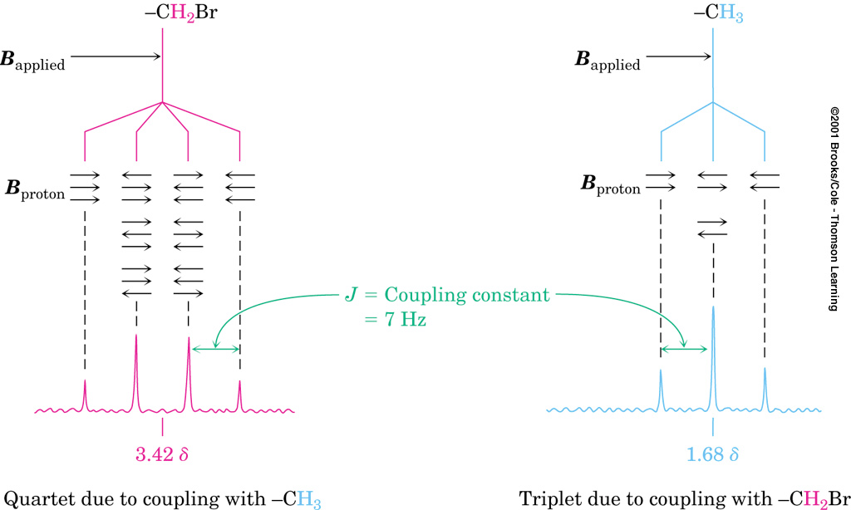

Slide 19
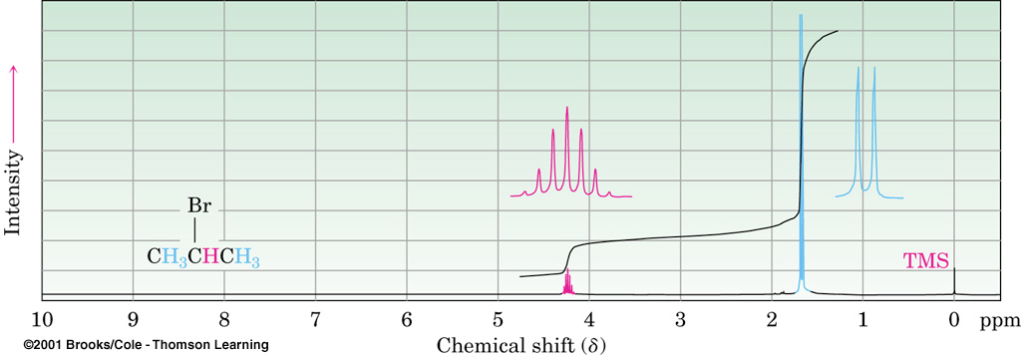

Slide 20
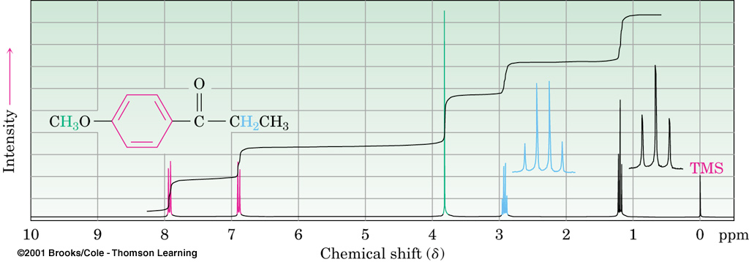

Slide 21
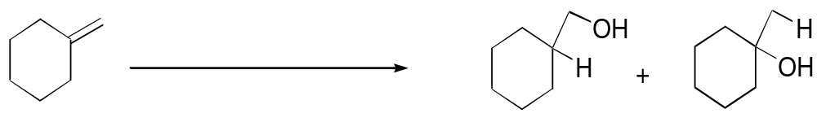
Identification of reaction products

Slide 22
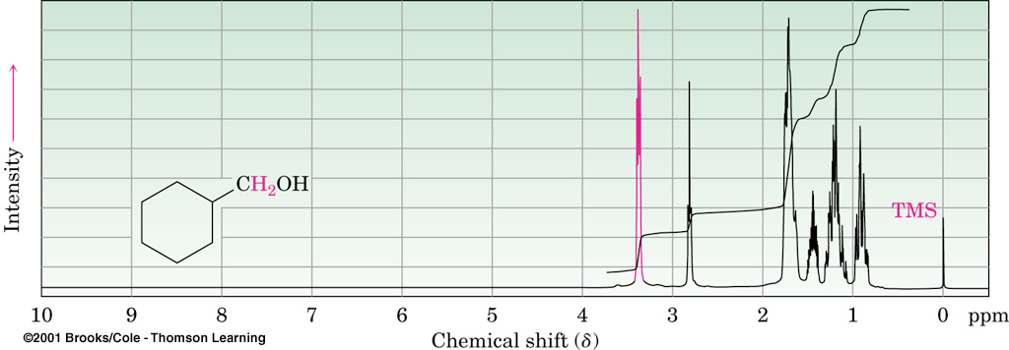

Slide 23
